Slide 1
Final requirements
Target
In order to better manage human resources and communicate work goals more conveniently.
platform
The system will be done in the form of a web page containing a database. Basic operations can be done through devices such as mobile phones or tablets.

Slide 2
Final requirements
work process
Staff registered an account
Log in to your account and fill in the working hours for each day of the week
Managers enter the dashboard page
Managers create work items
Select an employee's work item
Calculate the weekly working hours of employees and calculate their wages.

Slide 3
Final requirements
Other functions
Managers can select relevant people for work items to comment on them
Upload relevant files and resource files or audio and video files to train staff
All web pages and database files can be backed up by USB to avoid data loss caused by human or equipment damage.

Slide 4
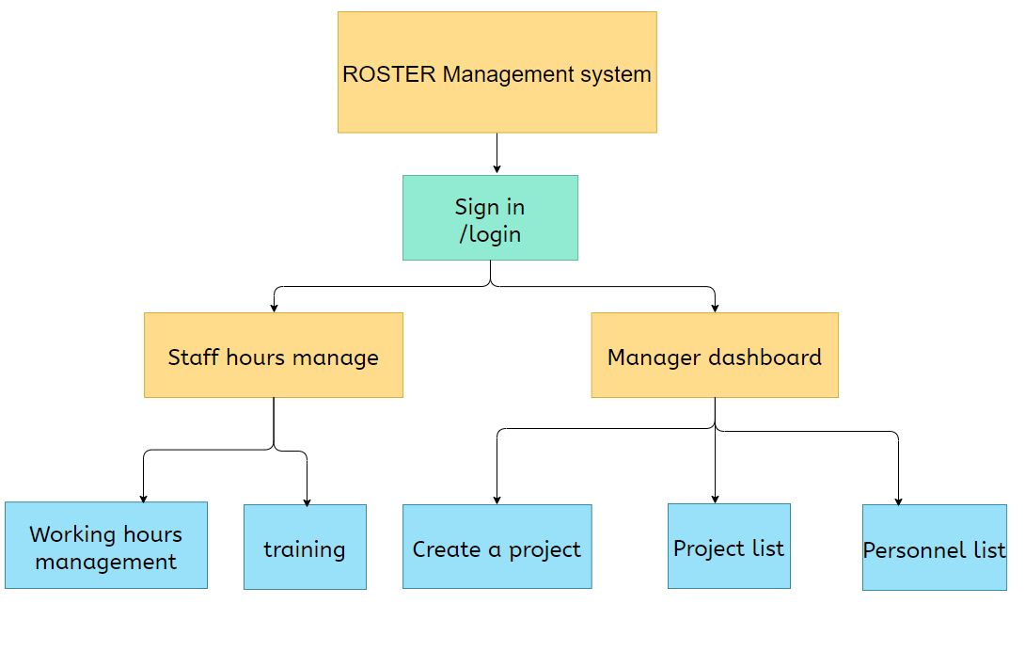
Sitemap

